Slide 1

ADVANCED
PROGRAMMING
PRACTICE(APP)-21CSC203P
PROJECT FIRST REVIEW
BY :
P.K.NAVEEN (RA2211030050009)
S.PRASANNA VENKATESH(RA2211030050023)
SHUBHAM (RA2211030050041)

Slide 2

PYTHON PROJECT

Slide 3
Problem statement
To predict the attacks on Network Intrusion Detection System (N-IDS) using Deep Neural Networks (DNNs).
In other words, the goal is to develop a DNN-based IDS that can accurately detect a wide range of attacks, including both known and zero-day attacks. The model will be trained on a dataset of network traffic data, including both normal and malicious traffic. Once trained, the model can be used to monitor live network traffic and generate alerts when it detects malicious activity.

Slide 4
ALGORITHMS USED:
Deep Neural Network (DNN):DNNs are a type of machine learning algorithm that are inspired by the structure and function of the human brain. DNNs are made up of layers of interconnected nodes, and they are able to learn complex patterns from data.
K-nearest neighbors(KNN): Is a classification algorithm that works by finding the K most similar data points to a new data point and then assigning the new data point to the class that is most common among the K nearest neighbors.
Support vector machines(SVM):Are a type of algorithm that can be used for both classification and regression tasks. SVMs work by finding a hyperplane in the feature space that separates the data into two classes

Slide 5
USE CASES:
Real-time network monitoring: DNN-based IDS models can be used to monitor network traffic in real time and generate alerts when malicious activity is detected. This can help to prevent attacks from succeeding and mitigate their impact.
Proactive threat detection: DNN-based IDS models can be used to detect threats before they launch. This can be done by analyzing historical data or by monitoring network traffic for patterns that are indicative of an impending attack.
Security incident response: DNN-based IDS models can be used to support security incident response by providing insights into the nature of an attack and its impact. This information can be used to develop and implement effective mitigation strategies.
Security research: DNN-based IDS models can be used to conduct security research and develop new methods for detecting and preventing cyber attacks.
Overall, DNN-based IDS models can be used in a variety of ways to improve the security of networks and systems.

Slide 6

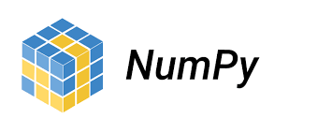
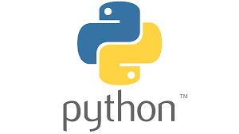


SOFTWARE USED:
VS-CODE
MODULUS USED:
NUMPY
PANDAS
SKLEARN

Slide 7
CODE:
import numpy as np
import pandas as pd
from sklearn.kernel_approximation import RBFSampler
from sklearn.linear_model import SGDClassifier
from sklearn.model_selection import train_test_split
from sklearn import svm
from sklearn.metrics import classification_report
from sklearn import metrics
from sklearn.linear_model import LogisticRegression
from sklearn.naive_bayes import GaussianNB
from sklearn.neighbors import KNeighborsClassifier
from sklearn.tree import DecisionTreeClassifier
from sklearn.metrics import (precision_score, recall_score,f1_score, accuracy_score,mean_squared_error,mean_absolute_error)
from sklearn.ensemble import AdaBoostClassifier
from sklearn.ensemble import RandomForestClassifier
from sklearn.preprocessing import Normalizer
from sklearn.model_selection import GridSearchCV

Slide 8
CODE:
from sklearn.metrics import (precision_score, recall_score,f1_score, accuracy_score,mean_squared_error,mean_absolute_error, roc_curve, classification_report,auc)
traindata = pd.read_csv('kddtrain.csv', header=None)
testdata = pd.read_csv('kddtest.csv', header=None)
X = traindata.iloc[:,1:42]
Y = traindata.iloc[:,0]
C = testdata.iloc[:,0]
T = testdata.iloc[:,1:42]
scaler = Normalizer().fit(X)
trainX = scaler.transform(X)
scaler = Normalizer().fit(T)
testT = scaler.transform(T)
traindata = np.array(trainX)
trainlabel = np.array(Y)
testdata = np.array(testT)
testlabel = np.array(C)

Slide 9
CODE:
print("-----------------------------------------LR---------------------------------")
model = LogisticRegression()
model.fit(traindata, trainlabel)
# make predictions
expected = testlabel
np.savetxt('classical/expected.txt', expected, fmt='%01d')
predicted = model.predict(testdata)
proba = model.predict_proba(testdata)
np.savetxt('classical/predictedlabelLR.txt', predicted, fmt='%01d')
np.savetxt('classical/predictedprobaLR.txt', proba)
y_train1 = expected
y_pred = predicted
accuracy = accuracy_score(y_train1, y_pred)
recall = recall_score(y_train1, y_pred , average="binary")
precision = precision_score(y_train1, y_pred , average="binary")
f1 = f1_score(y_train1, y_pred, average="binary")
print("accuracy")
print("%.3f" %accuracy)
print("precision")

Slide 10
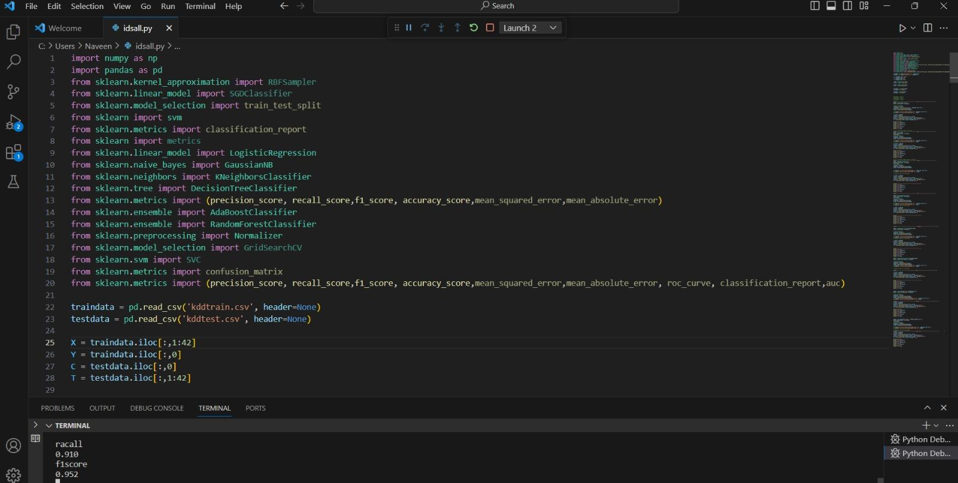
CODE:
print("%.3f" %precision)
print("racall")
print("%.3f" %recall)
print("f1score")
print("%.3f" %f1)
GITHUB LINK:

Slide 11
OUTCOME:

Slide 12
RESULT & DISCUSSION:
REFERENCES:

Slide 13
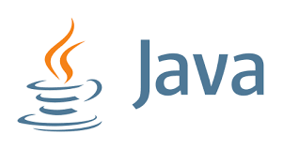
JAVA PROJECT

Slide 14
Problem statement
Manual outpass and leave request and approval processes are inefficient, time-consuming, and error-prone.so to overcome this problem we came with an idea
To design and implement a new outpass or leave request and approval application using Java programming language in the Android Studio development environment.

Slide 15
ALGORITHMS USED:
Get the user's input from the registration form.
Validate the user's input.
If the input is valid, register the user in the system.
If the registration is successful, navigate to the next screen.

Slide 16
USE CASES:
Employee submits a leave request for a medical appointment. The request is automatically routed to the employee's supervisor for approval and the leave is recorded in the system.
Student submits an outpass request to leave campus early for a family event. The request is automatically routed to the student's academic advisor for approval. The advisor can review the request and approve it if they have no concerns. The student receives a notification that their request has been approved, and they are able to leave campus early.
Non-profit employee submits an outpass request to attend a training conference. The request is automatically routed to the employee's director for approval. The director can review the request and approve it if the training is relevant to the employee's job and there is no budget constraint. The employee receives a notification that their request has been approved, and they are able to attend the conference.
Overall, the application could be used for any situation where an employee needs to request permission from a supervisor or manager. It could be used to streamline a variety of manual processes and make it easier for employees to get the time off they need.

Slide 17



SOFTWARE USED:
Android STUDIO
MODULUS USED:

Slide 18
CODE:
import android.content.Intent
import android.os.Bundle
import android.view.View
import android.widget.Button
import androidx.appcompat.app.AppCompatActivity
class RegistrationActivity : AppCompatActivity() {
override fun onCreate(savedInstanceState: Bundle?) {
super.onCreate(savedInstanceState)
setContentView(R.layout.activity_registration)
val registerButton: Button = findViewById(R.id.registerButton)
registerButton.setOnClickListener {
// Handle registration logic here
// You can add your registration code here
// If registration is successful, navigate to the next screen
val intent = Intent(this, NextActivity::class.java)
startActivity(intent)
}
}
}

Slide 19
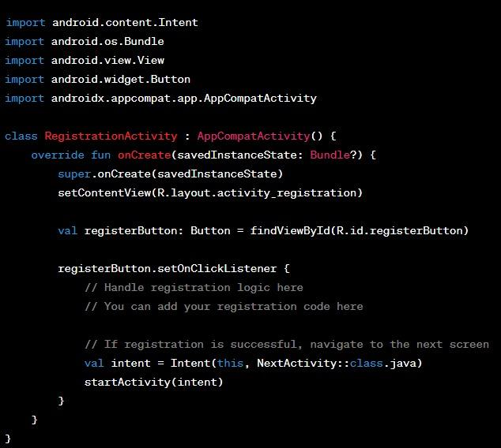
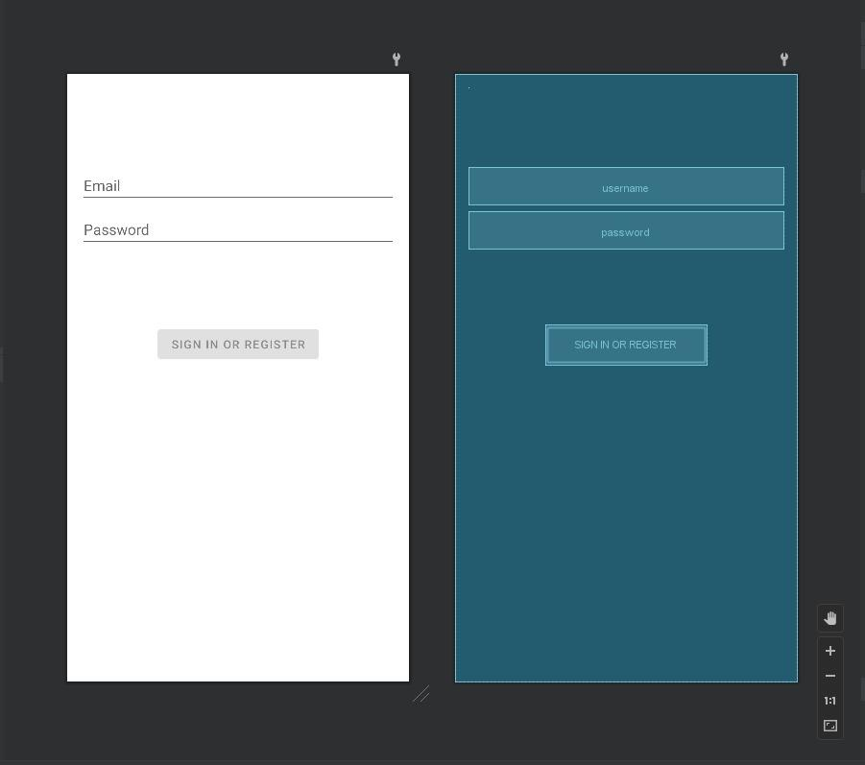
CODE:
GITHUB LINK:

Slide 20
OUTCOME:

Slide 21
RESULT & DISCUSSION:
REFERENCES:

Slide 22
THANK YOU!!
FULL PROJECT REPORT FOR PYTHON:
FULL PROJECT REPORT FOR JAVA:
QUESTIONS??
…………………………………………,

